Slide 1
An Interactive Patient Portal to Enhance Patient-Provider Communications for Improved Healthcare Outcomes
SHREYA CHAKRABARTI
Graduate Committee Members:
-Dr.Yuni Xia -Dr.Wu Huanmei
-Dr.Xukai Zou
Notes:
Good Morning I am here to present my work done by me in my MS Project – An Interactive Patient Portal to Enhance Patient Provider Communications I thank all my advisors to grant me this opportunity to work on this project

Slide 2

Introduction
Internet has become the modern form of communication in industries all across the world
Technology and internet together have come up with solutions to problems in every industry
Communication is a Major aspect of this billion dollar industry
Notes:
- With the advent of internet every industry is benefitting mainly in the department of communication - From traditional chat rooms to real time chatting the internet has evolved tremendously - What attracts the world to the internet is the ease of communication with which one person can connect with the other

Slide 3
What is a Patient Portal?
A patient portal is a secure online website that gives patients convenient 24-hour access to personal health information from anywhere with an Internet connection
Healthcare can be defined to be a 80% responsibility of the patient and 20% responsibility of the healthcare provider
Many large healthcare providers like Franciscan, Indiana School of Medicine, Apollo etc. use health care portals
Notes:
- Medical industry is not averse to the internet rage
Patient Portals is one such form of communication between a patient and his provider - It provides a 24-hour access to a patients health information to both the patient and the provider - Healthcare is generally defined as 80% responsibility of the patient and only 20% responsibility of the doctor -Patient Portals were designed with this vision in mind

Slide 4
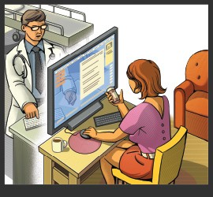
Patient Portal Problems
Patients Version
No Everyday Visits
No Participation
Doctors Version
Too much time spent on implementing, learning and training them about its utility
Reduces productive face-time with patients
Notes:
- However Patient Portals in general is not a very successful project by the medical industry -Some of the reasons I found on the internet for the same are that patients claimed they did not use the portal everyday as they visited the portal only when they had to schedule visits,pay bills or send messages to the doctor - I have tried to address this in my portal by increasing a patients everyday participation in the portal

Slide 5
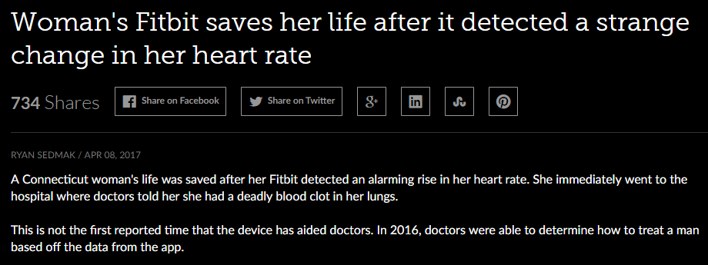
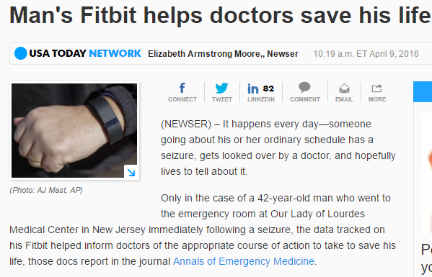
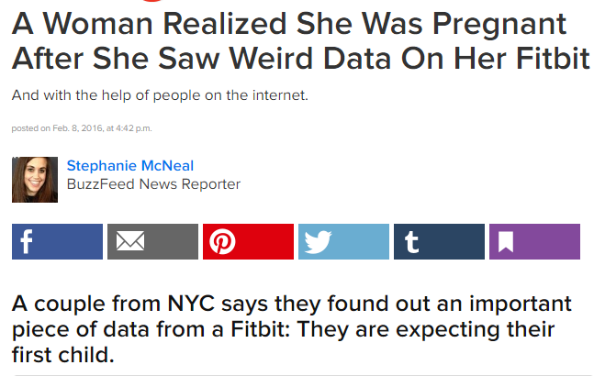
“Vitals” Importance!
Notes:
-Apps and devices like google fit and Fitbit have been a proven success in the motivational health programs
-I read some case studies where active Fitbit and Google Fit users benefitted by regular monitoring of signals like heartbeat - I googled about doctor’s opinions about the same - I found that even though doctors did not rely on this data completely due to the doubts about accuracy of the device - But they did agree that this type of monitoring keeps a patient motivated towards his/her health

Slide 6
Patient Portal Features
Improved Patient Engagement
Search for Doctor
Schedule Appointment
Record Vitals
Zip Code
Doctor’s Specialty
Avoid Appointment Overlap
Heartbeat
Blood-Pressure
Blood-Sugar
Temperature
Store Health Reports Online
Review Doctor’s Services
Message Doctor
Minimum Payment
Customizable Vital
Weight
Notes:
Based on the case studies and other patient portals present I designed these features to be present in my portal

Slide 7
Technology Used
For Website Development
Ruby On Rails
For Control Features
JQuery
SQLite
Bootstrap
For Database
Styling
PostgreSQL
CSS
Notes:
I Have used these tools for the design

Slide 8
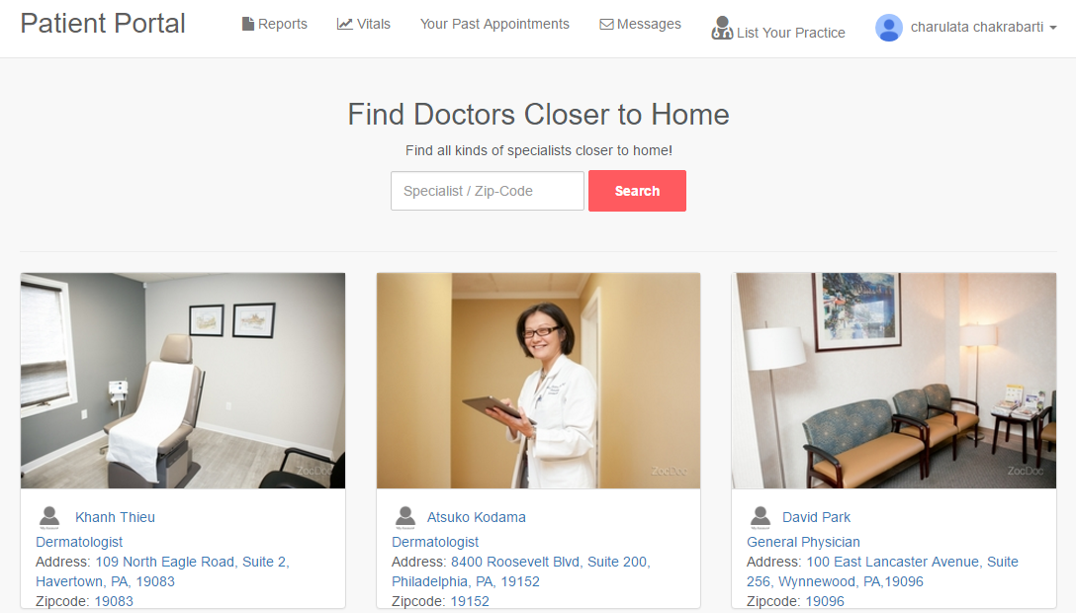
Home Page & Search Feature
Search using Zip Code or Specialty

Slide 9
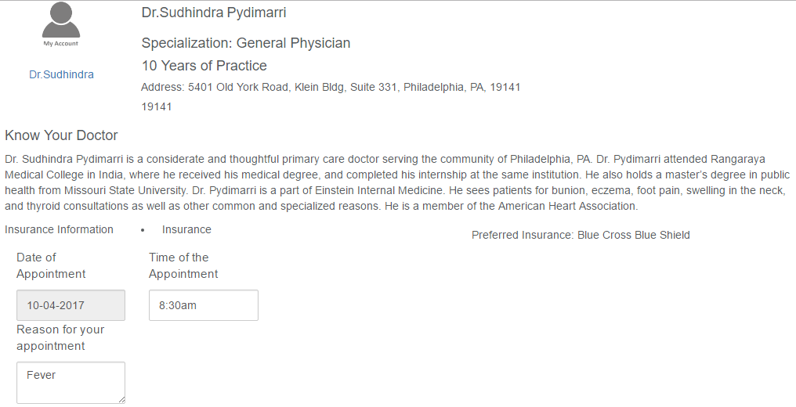
Schedule Appointments
Time of the Appointment
Date of Appointment
Reason for Appointment

Slide 10
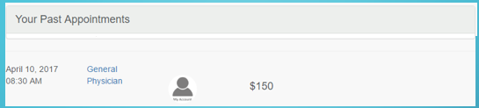
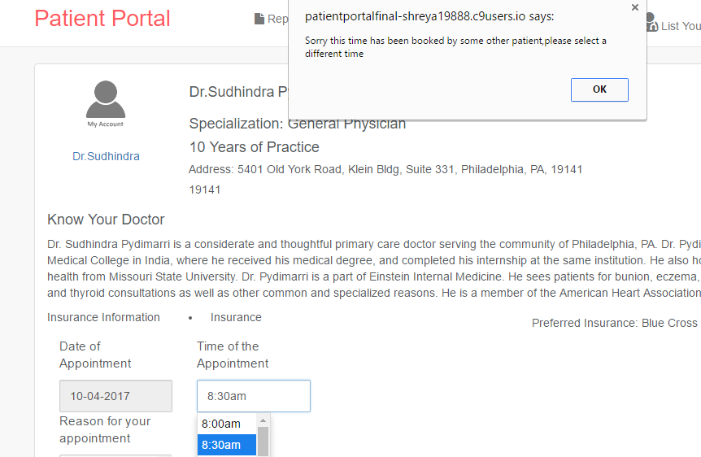
User 1 Appointment Scheduled
Error on Appointment Conflict with the same Doctor

Slide 11
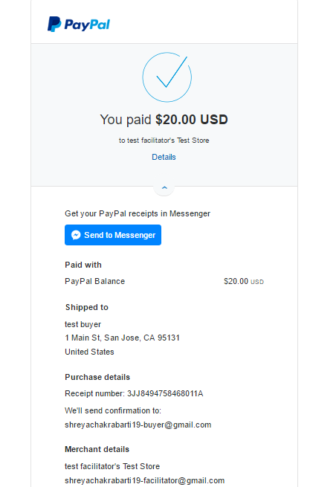
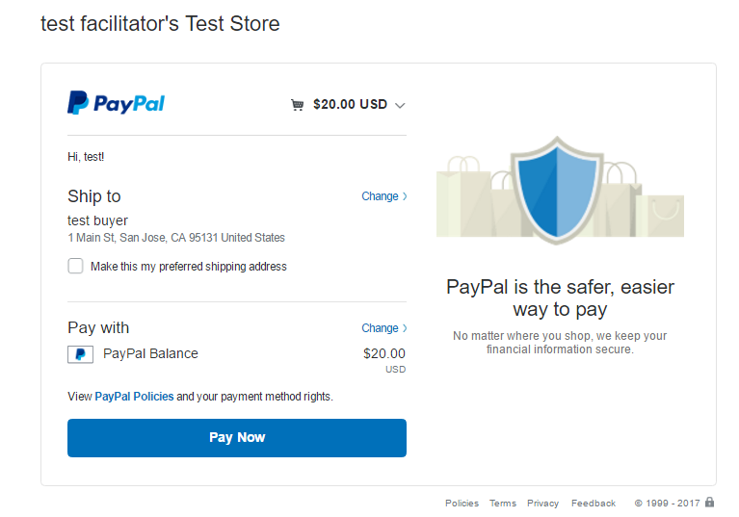
Payment Feature
Minimum payment required by doctor for booking the appointment

Slide 12
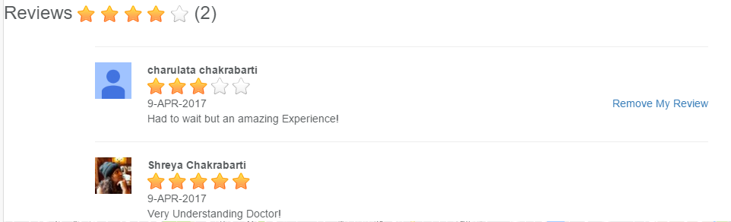
Review Feature
User can delete only his/her reviews
Average of all Reviews

Slide 13
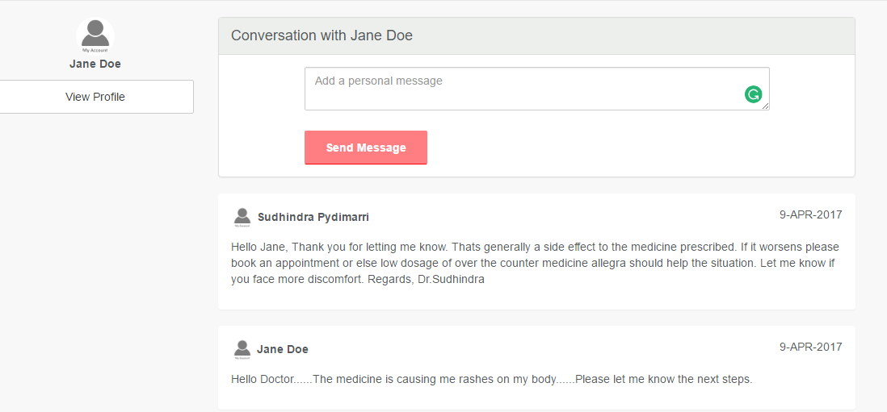
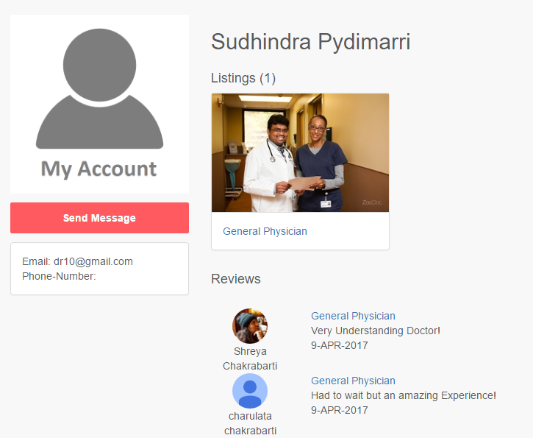
Message Feature
Message Received from a Doctor
Send Message from the Doctors Profile Page
Message Sent to the Doctor

Slide 14
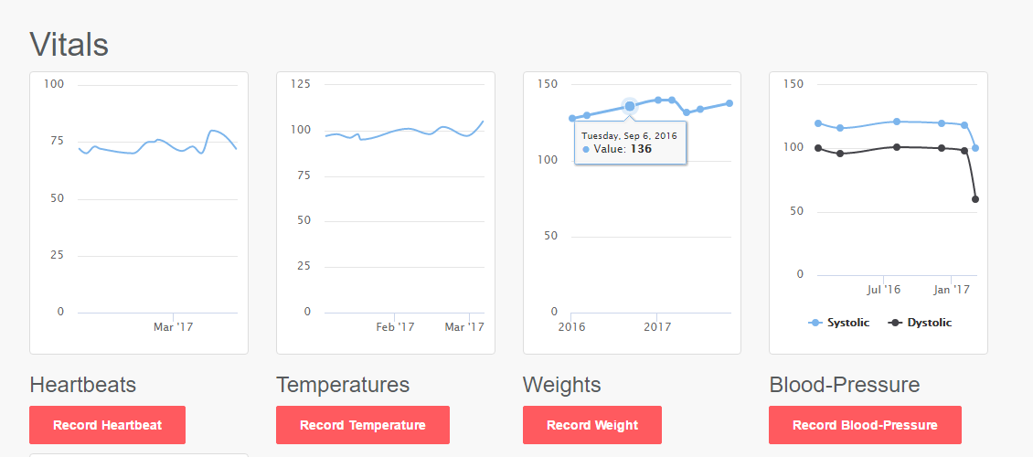

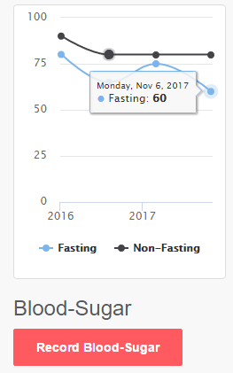
Records Vitals
Patient can Record and View values of their self entered Vitals

Slide 15
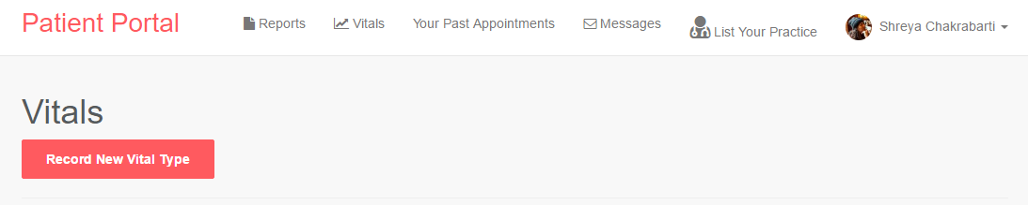
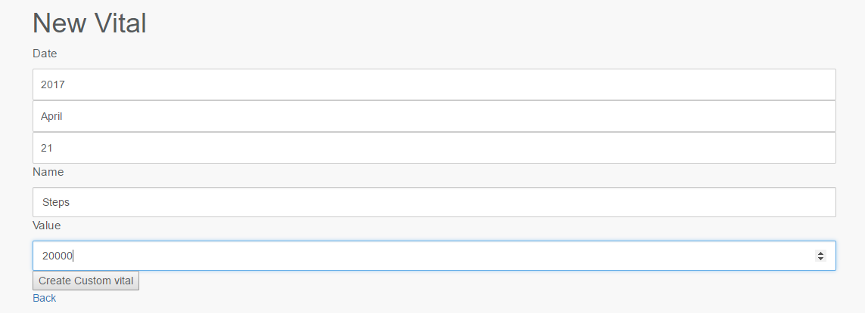
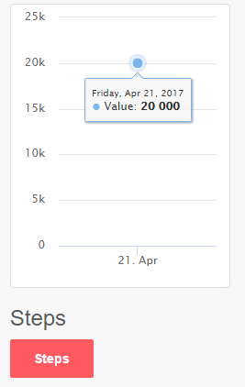
Customizable Vital
Vital Graph

Slide 16
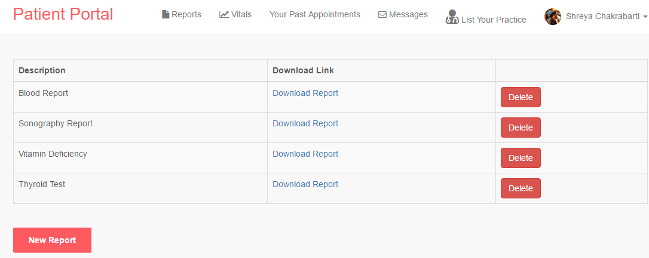
Keep Record of Health Reports
Users can delete old unnecessary reports
Allows Users to upload health reports and download them as and when needed

Slide 17
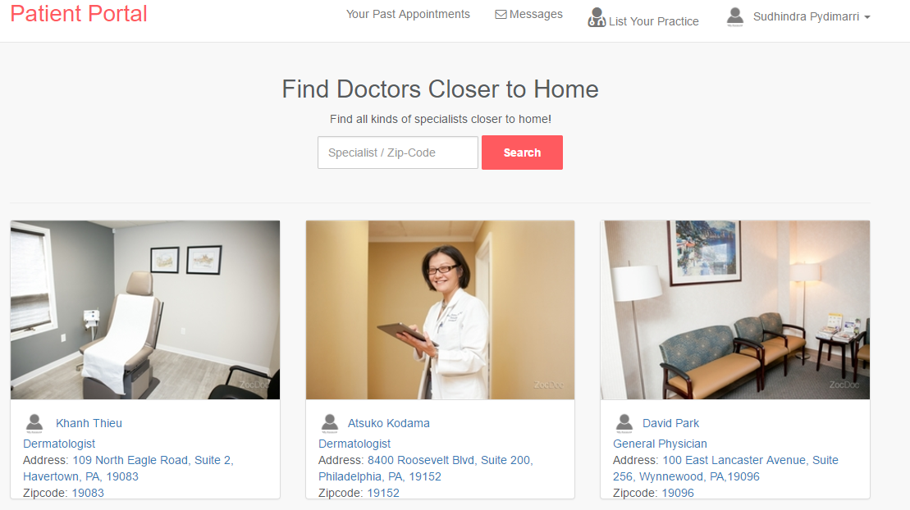
Doctor’s View
No Reports and Vitals Page

Slide 18
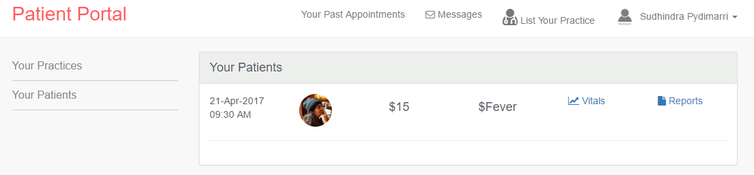
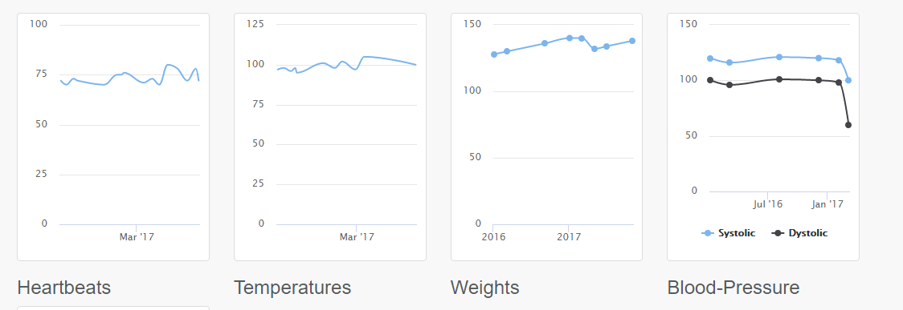
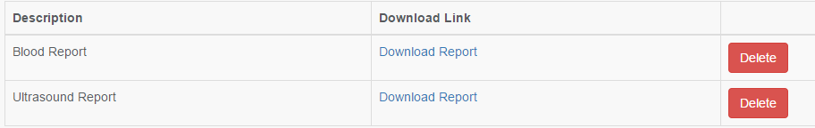
Doctor’s View
Provides Patients Vitals and Reports
Patients Vitals View
Patients Reports View

Slide 19
Demo of the Website
https://patientportalfinal-shreya19888.c9users.io/

Slide 20
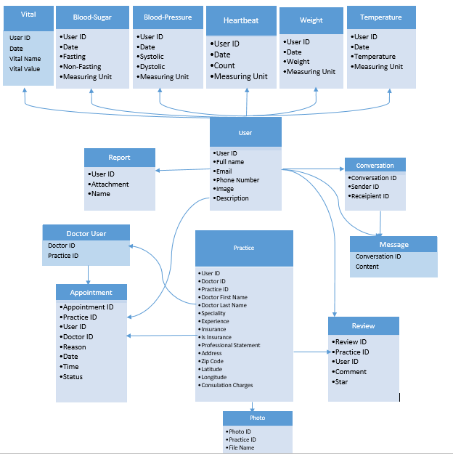
Entity Relationship Diagram for Database

Slide 21
Challenges
Steep Learning Curve for Technologies used
Research about Integrating Google-Fit, Fitbit data into the app
Research of various Gems used in the Rails Technology was time consuming
Data Research

Slide 22
Future Work
Integrate Google-Fit or Fitbit data for direct upload of steps, heartbeat and other measurable vitals on the portal
Cloud Integration for higher capacity to store Health Reports

Slide 23

QUESTIONS?

Slide 24


Slide 25
References
Image References
Text References
http://www.physicianspractice.com/patient-portals
http://blogs.helsinki.fi/ict-driving-licence-additional-reading/internet-communication/
https://www.healthit.gov/providers-professionals/faqs/what-patient-portal
https://getreferralmd.com/2013/10/patient-engagement-patient-portal/
Code
https://github.com/shreya19888/Patient_Portal_Masters_Project_Final_Submission
Website
Digital Ocean Website - http://104.236.115.133/
https://patientportalfinal-shreya19888.c9users.io/

